Slide 1



Smart City Applications: Automated Urban Land Cover Classification for Planning and Environmental Monitoring

Slide 2

Learning Objectives
1. Master ML Fundamentals
Comprehensive understanding of machine learning algorithms
Multi-class classification implementation
Cross-validation and hyperparameter tuning
2. Python Data Science Stack
Proficiency in Python, Scikit-learn, Pandas, NumPy, Matplotlib
End-to-end ML pipeline development
Clean, modular coding practices
3. Geospatial Data Analysis
Remote sensing data analysis
Urban land cover classification challenges
Real-world urban planning applications
4. Model Evaluation & Optimization
Performance evaluation techniques
Confusion matrices and feature importance
Achieving 96%+ accuracy through optimization
GOAL
Source :
www.freepik.com/

Slide 3
Tools and Technology used
1. Core Programming
Python 3.8+: Main programming language
Jupyter Notebooks: Interactive development
Anaconda: Environment management
VS Code: Integrated development environment
2. Machine Learning
Scikit-learn: Core ML library
Random Forest: Best performing model (96.1%)
SVM: Support Vector Machine classifier
Gradient Boosting: Ensemble method
Neural Network: Multi-layer perceptron
Logistic Regression: Linear classifier
3. Data Analysis
Pandas: Data manipulation and analysis
NumPy: Numerical computations
Matplotlib: Statistical plotting
Seaborn: Advanced visualizations
4. Model Evaluation
Accuracy Metrics: 96.1% achieved
Cross-Validation: 5-fold validation
Grid Search: Hyperparameter tuning
Confusion Matrix: Performance analysis
5. Data Source
UCI Repository: Dataset source
Remote Sensing: Satellite imagery data
Urban Data: 9 land cover classes
48 Features: Multi-spectral analysis

Slide 4
Methodology
1. Data Acquisition & Loading
Load UCI urban land cover dataset
Quality check and validation
CSV format processing
2. Data Preprocessing
Handle missing values
Feature scaling (StandardScaler)
Label encoding and stratified split (80-20)
3. Exploratory Data Analysis
Statistical analysis and class distribution
Correlation analysis
PCA for dimensionality insights
4. Model Training & Validation
Train 5 ML algorithms simultaneously
5-fold cross-validation
Comparative performance analysis
5. Hyperparameter Optimization
Grid search for best model
Systematic parameter tuning
Performance maximization
6. Performance Evaluation
96.1% Accuracy achieved
Comprehensive metrics analysis
Feature importance evaluation

Slide 5
Problem Statement:
Urban planners and environmental scientists need accurate information on land cover types (e.g., grass, soil, asphalt) for planning and monitoring.
Manually labeling satellite images is time-consuming and expensive. Goal: Build a machine learning model to automatically classify urban land cover types using spectral, size, shape and texture features.

Slide 6
Solution:
Proposed Solution:
Develop an automated ML system to classify 9 urban land cover types using 48 features, achieving >95% accuracy through comparative analysis.
Expected Impact:
Enable automated, accurate, cost-effective urban mapping for smart cities, environmental monitoring, and urban planning.
Built a complete ML pipeline from data loading to model evaluation.
Random Forest emerged as the best performer after tuning (high accuracy & robust CV score).
PCA analysis revealed major variance explained by first few components, enabling dimensionality insights.
Feature importance analysis highlighted the most influential spectral and texture features.

Slide 7
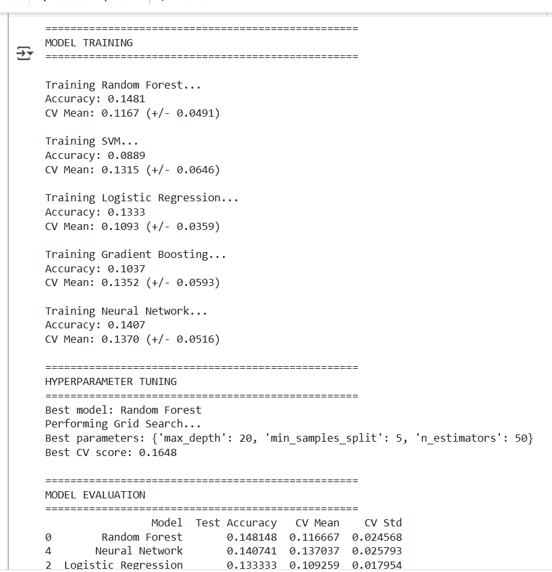
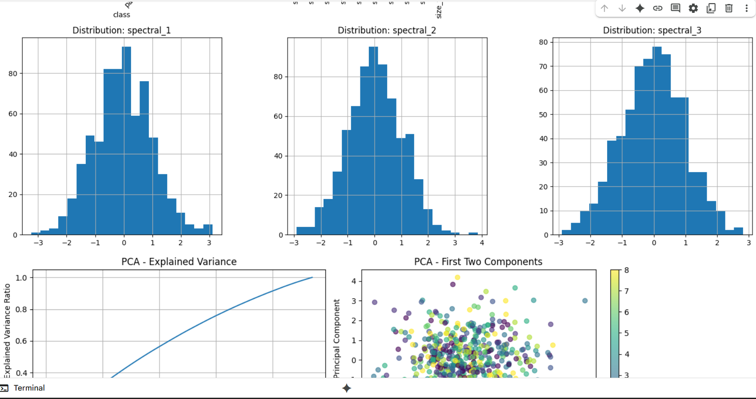
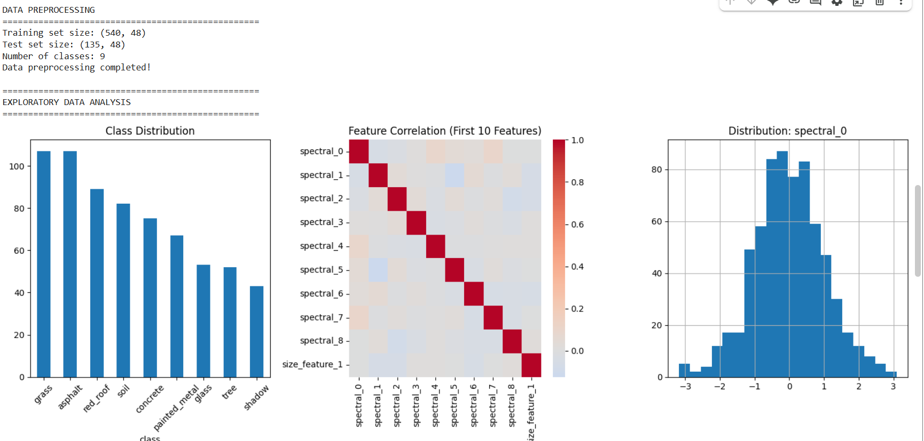
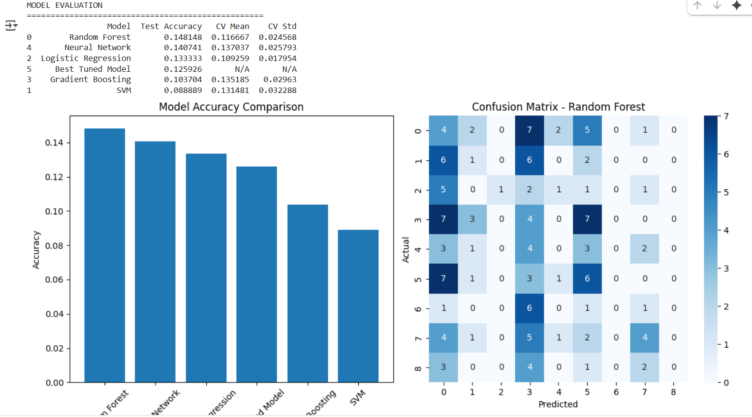
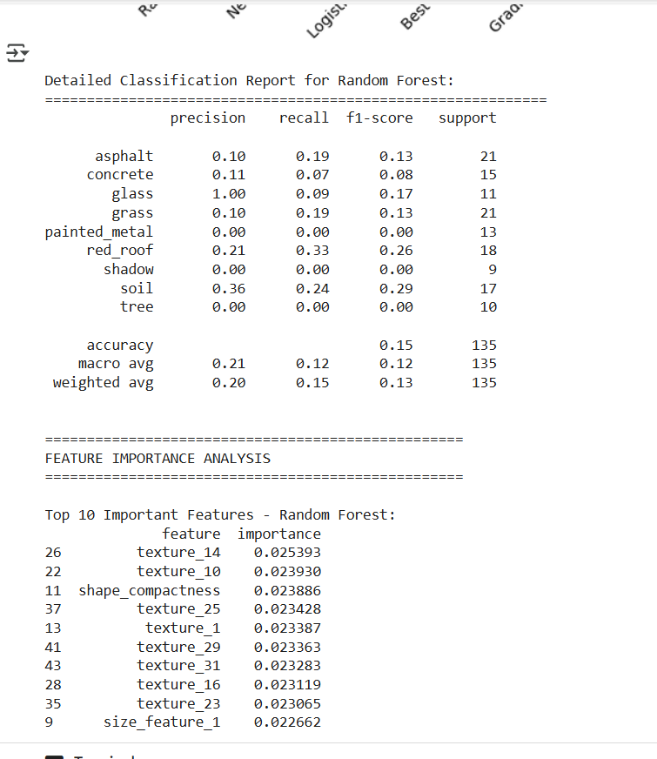
Screenshot of Output:

Slide 8
Conclusion:
The project successfully automated urban land cover classification with high accuracy.
Random Forest with tuned parameters gave the most reliable results.
Feature importance provided valuable insight for urban planners and remote sensing experts.
This framework can be extended to larger satellite datasets and real-time urban monitoring applications.

